Slide 1
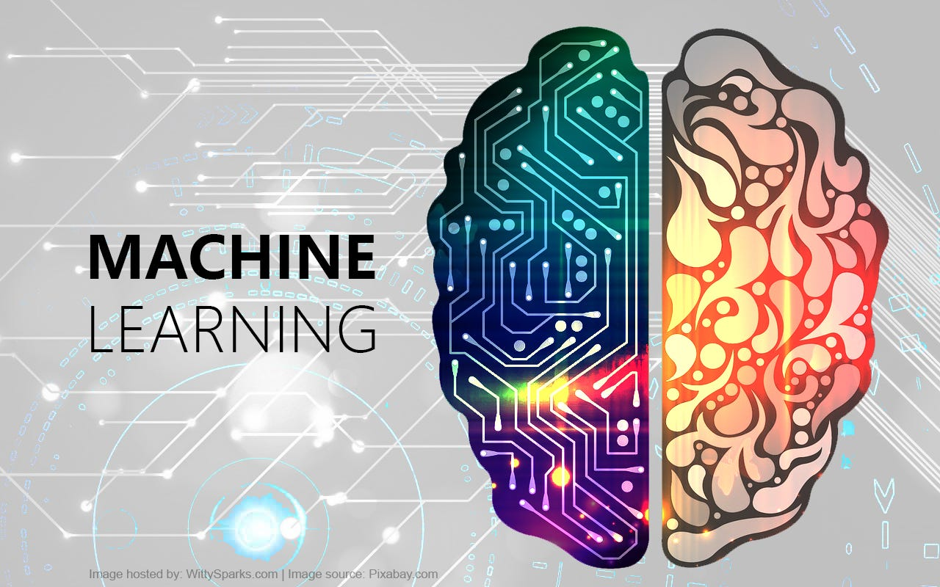
20CSD112
Machine Learning
Komal Kumar. N
Assistant Professor
Dept. Of Data Science

Slide 2
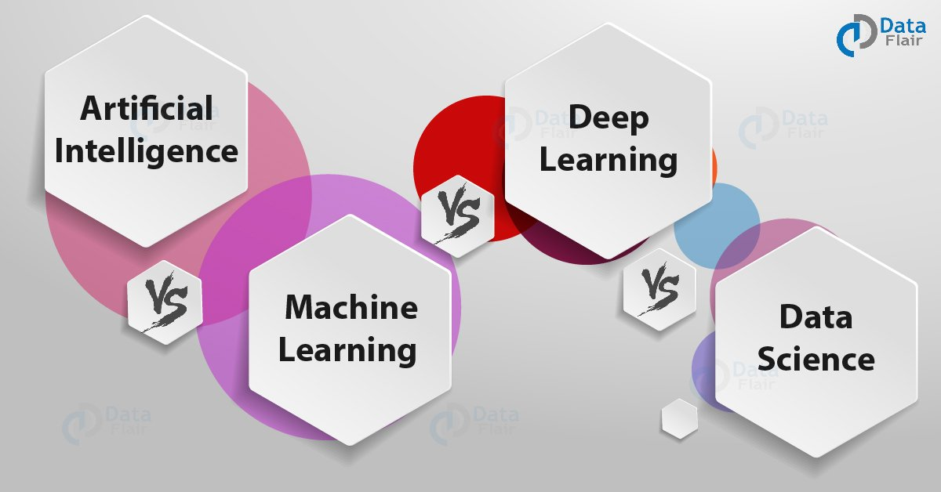

Slide 3
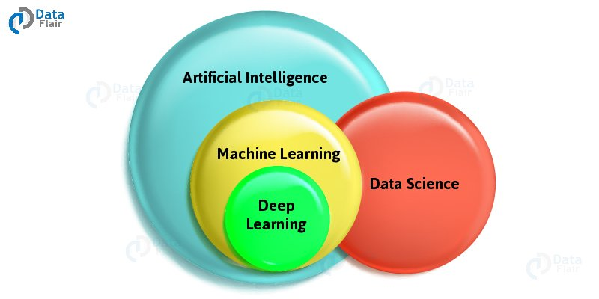
AI vs ML vs DL vs DS

Slide 4
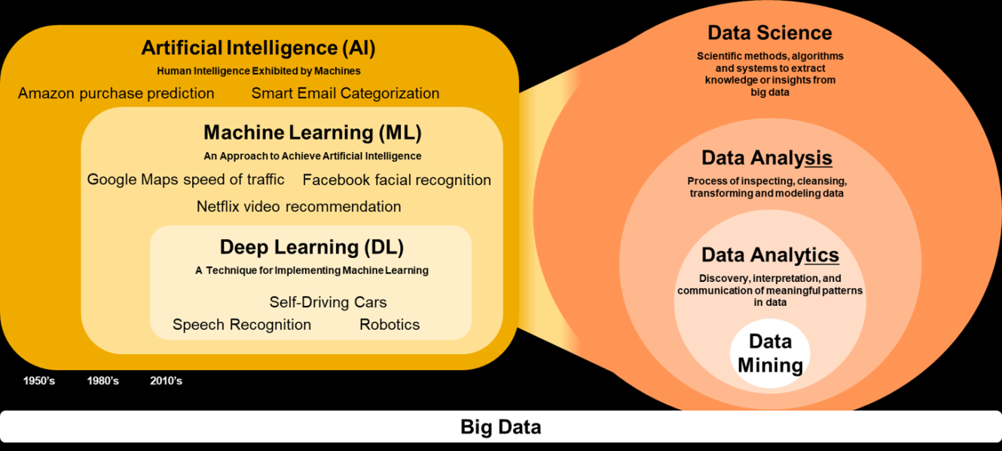

Slide 5
What is Machine Learning?
“Learning is any process by which a system improves performance from experience.”
- Herbert Simon
Definition by Tom Mitchell (1998):
Machine Learning is the study of algorithms that
improve their performance P
at some task T
with experience E.
A well-defined learning task is given by <P, T, E>.
Machine Learning is concerned with giving machines the ability to learn by training algorithms on a huge amount of data. It makes use of algorithms and statistical models to perform a task without needing explicit instructions.
3

Slide 6
Traditional Programming
Data Program
Computer
Output
Machine Learning
Data Output
Computer
Program
4
Slide credit: Pedro Domingos

Slide 7

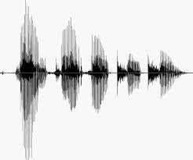
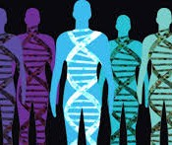
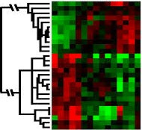
When Do We Use Machine Learning?
ML is used when:
Human expertise does not exist (navigating on Mars)
Humans can’t explain their expertise (speech recognition)
Models must be customized (personalized medicine)
Models are based on huge amounts of data (genomics)
Learning isn’t always useful:
There is no need to “learn” to calculate payroll
Based on slide by E. Alpaydin
5

Slide 8
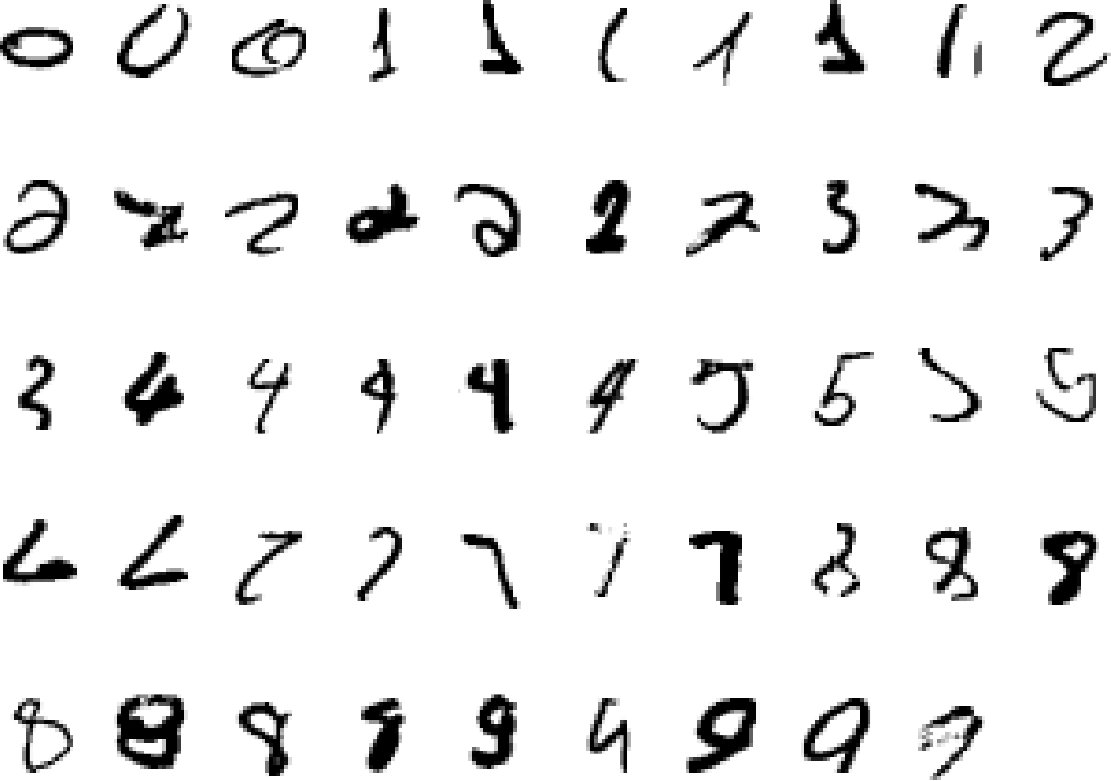
A classic example of a task that requires machine learning: It is very hard to say what makes a 2
6
Slide credit: Geoffrey Hinton

Slide 9
Some more examples of tasks that are best solved by using a learning algorithm
Recognizing patterns:
Facial identities or facial expressions
Handwritten or spoken words
Medical images
Generating patterns:
Generating images or motion sequences
Recognizing anomalies:
Unusual credit card transactions
Unusual patterns of sensor readings in a nuclear power plant
Prediction:
Future stock prices or currency exchange rates
7
Slide credit: Geoffrey Hinton

Slide 10
Sample Applications
Web search
Computational biology
Finance
E-commerce
Space exploration
Robotics
Information extraction
Social networks
Debugging software
[Your favorite area]
8

Slide 11
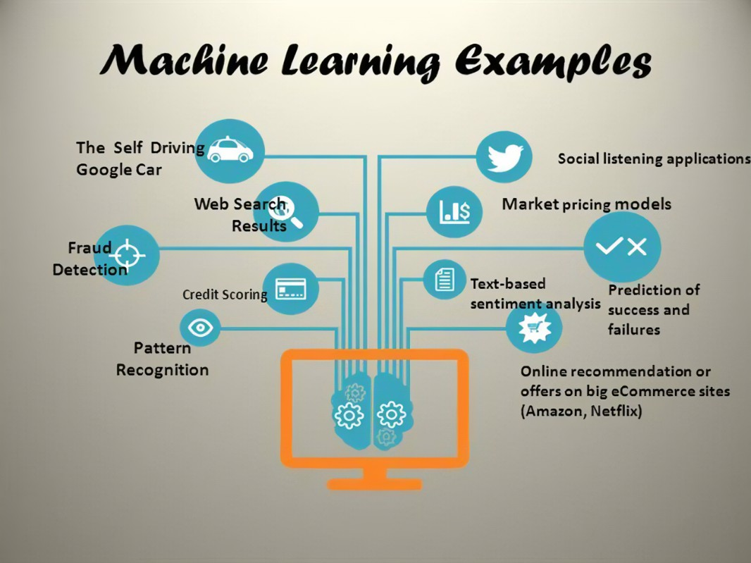

Slide 12
Best Programming languages for ML
Python,
java,
C,
C++,
Shell,
R,
JavaScript,
Scala,
Shell,
Julia

Slide 13
Evaluation
Accuracy
Precision and recall
Squared error
Likelihood
Posterior probability
Cost / Utility
Margin
Entropy
K-L divergence
Etc.

Slide 14

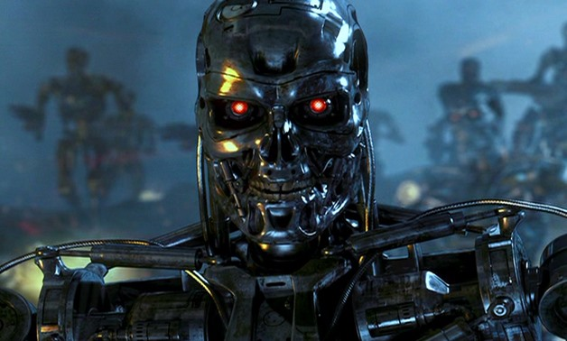
Issues in ML
Many machine learning/AI projects fail (Gartner claims 85 %)
Ethics, e.g., Amazon has/had sub-par employees fired by an AI automatically

Slide 15
Machine Learning often deals with the following issues:
Collecting data
Filtering data
Analyzing data
Training algorithms
Testing algorithms
Using algorithms for future predictions

Slide 16

Reasons for failure
Asking the wrong question
Trying to solve the wrong problem
Not having enough data
Not having the right data
Having too much data
Hiring the wrong people
Using the wrong tools
Not having the right model
Not having the right yardstick
Notes:
https://www.kdnuggets.com/2018/07/why-machine-learning-project-fail.html

Slide 17
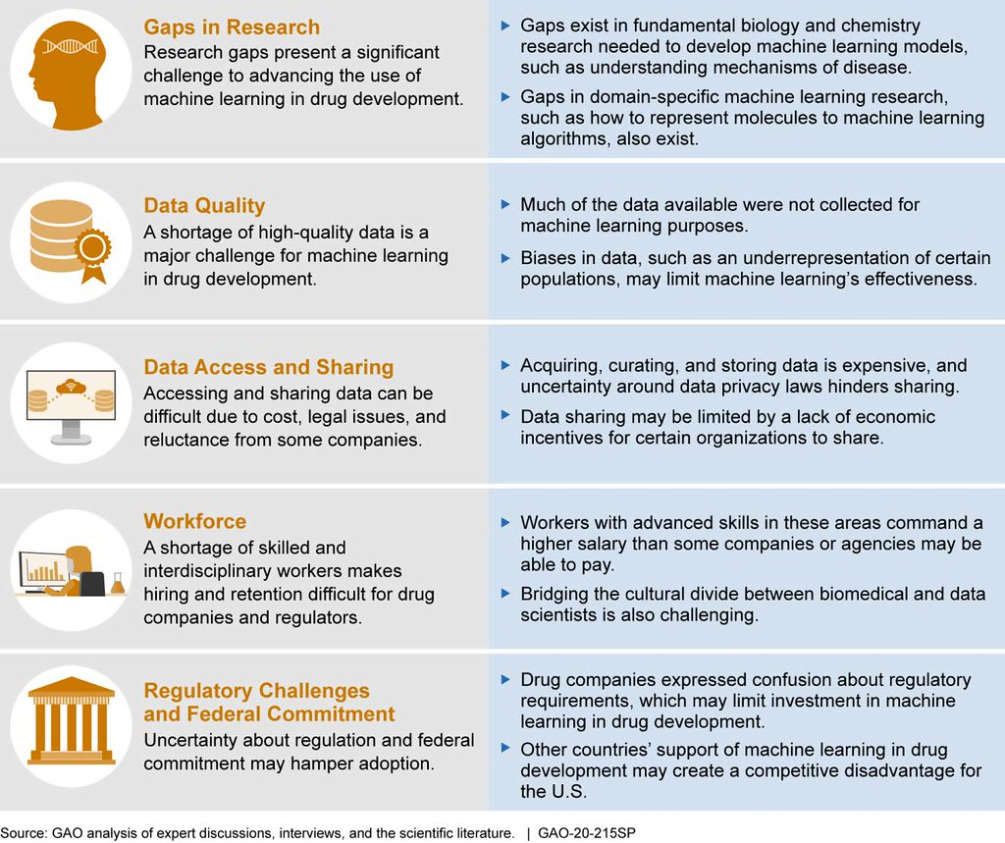
Challenges in ML

Slide 18
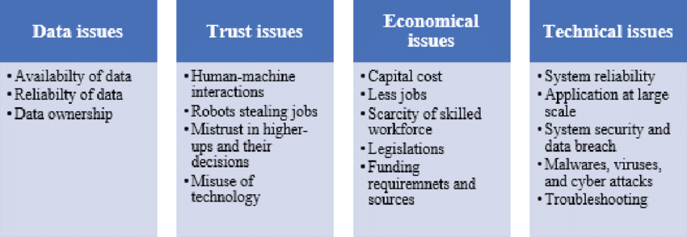

Slide 19
Frameworks
Programming languages
Python
R
C++
...
Many libraries
scikit-learn
PyTorch
TensorFlow
Keras
…
Fast-evolving ecosystem!
classic machine learning
deep learning frameworks

Slide 20

scikit-learn
Nice end-to-end framework
data exploration (+ pandas + holoviews)
data preprocessing (+ pandas)
cleaning/missing values
normalization
training
testing
application
"Classic" machine learning only
https://scikit-learn.org/stable/

Slide 21


Keras
High-level framework for deep learning
TensorFlow backend
Layer types
dense
convolutional
pooling
embedding
recurrent
activation
…
https://keras.io/

Slide 22

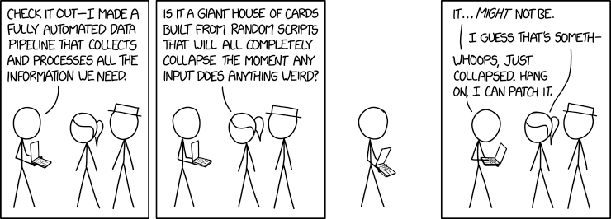
Data pipelines
Data ingestion
CSV/JSON/XML/H5 files, RDBMS, NoSQL, HTTP,...
Data cleaning
outliers/invalid values? → filter
missing values? → impute
Data transformation
scaling/normalization
Must be done systematically

Slide 23
State of the Art Applications of Machine Learning
11

Slide 24
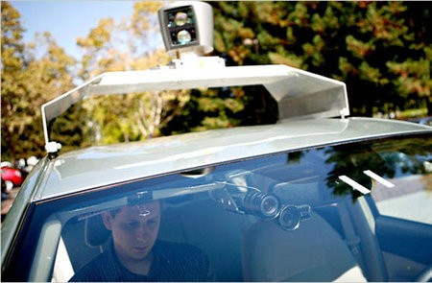
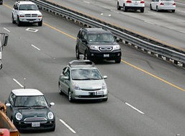
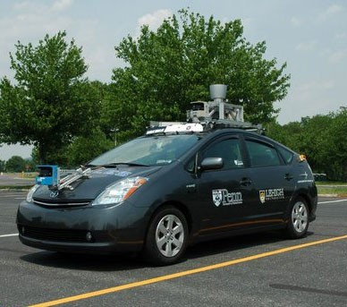
Autonomous Cars
Nevada made it legal for autonomous cars to drive on roads in June 2011
As of 2013, four states (Nevada, Florida, California, and Michigan) have legalized autonomous cars
Penn’s Autonomous Car →
(Ben Franklin Racing Team)
12

Slide 25
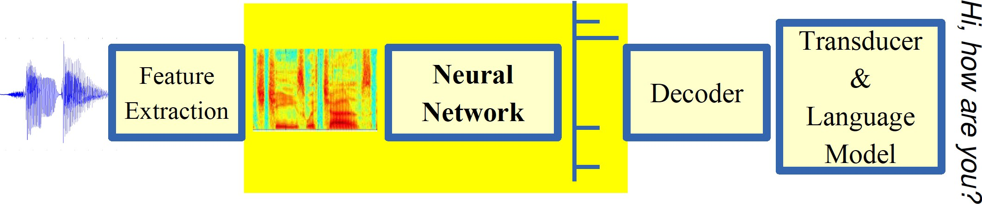
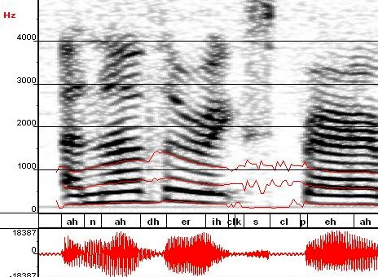
Machine Learning in Automatic Speech Recognition
A Typical Speech Recognition System
ML used to predict of phone states from the sound spectrogram
Deep learning has state-of-the-art results
# Hidden Layers | 1 | 2 | 4 | 8 | 10 | 12
Word Error Rate % | 16.0 | 12.8 | 11.4 | 10.9 | 11.0 | 11.1
Baseline GMM performance = 15.4%
[Zeiler et al. “On rectified linear units for speech recognition” ICASSP 2013]
21

Slide 26
Types of Machine Learning
23

Slide 27
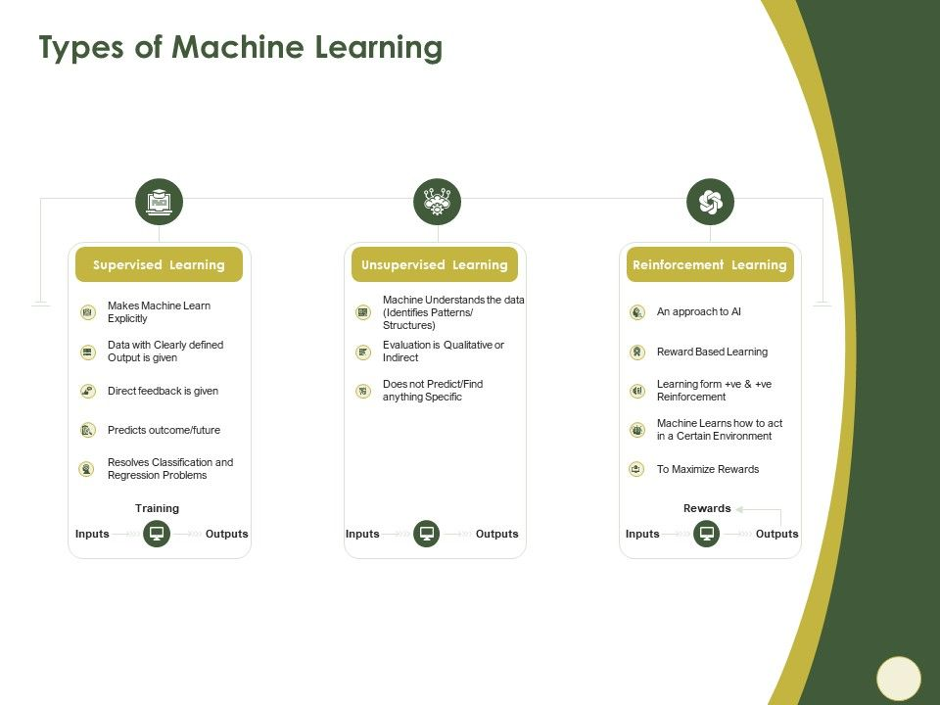
Defining the Learning Task
Improve on task T, with respect to performance metric P, based on experience E
T: Playing checkers
P: Percentage of games won against an arbitrary opponent E: Playing practice games against itself
T: Recognizing hand-written words
P: Percentage of words correctly classified
E: Database of human-labeled images of handwritten words
T: Driving on four-lane highways using vision sensors
P: Average distance traveled before a human-judged error
E: A sequence of images and steering commands recorded while observing a human driver.
T: Categorize email messages as spam or legitimate. P: Percentage of email messages correctly classified. E: Database of emails, some with human-given labels
10
Slide credit: Ray Mooney

Slide 28
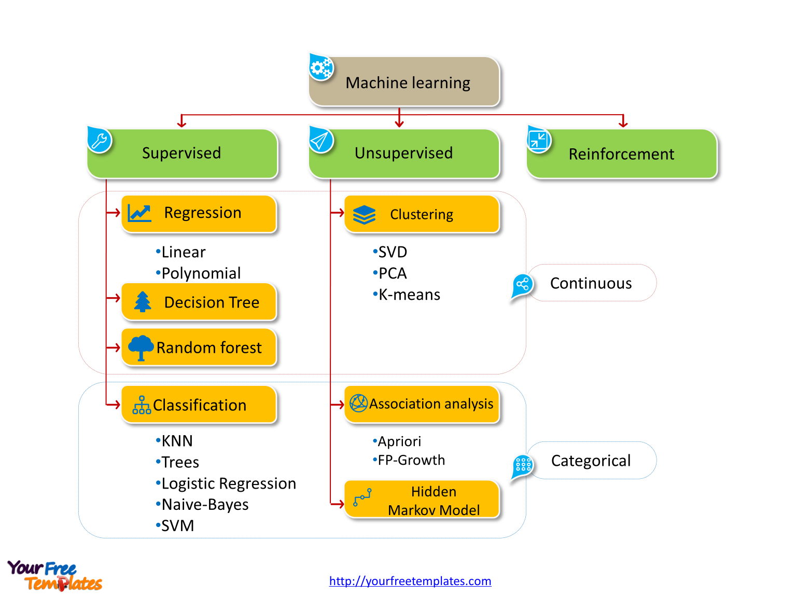

Slide 29
Supervised Learning: Uses
Example: decision trees tools that create rules
Prediction of future cases: Use the rule to predict the output for future inputs
Knowledge extraction: The rule is easy to understand
Compression: The rule is simpler than the data it explains
Outlier detection: Exceptions that are not covered by the rule, e.g., fraud
29

Slide 30
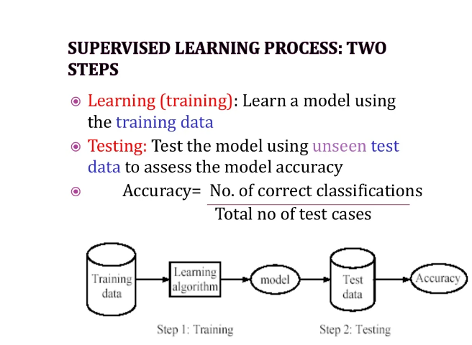

Slide 31
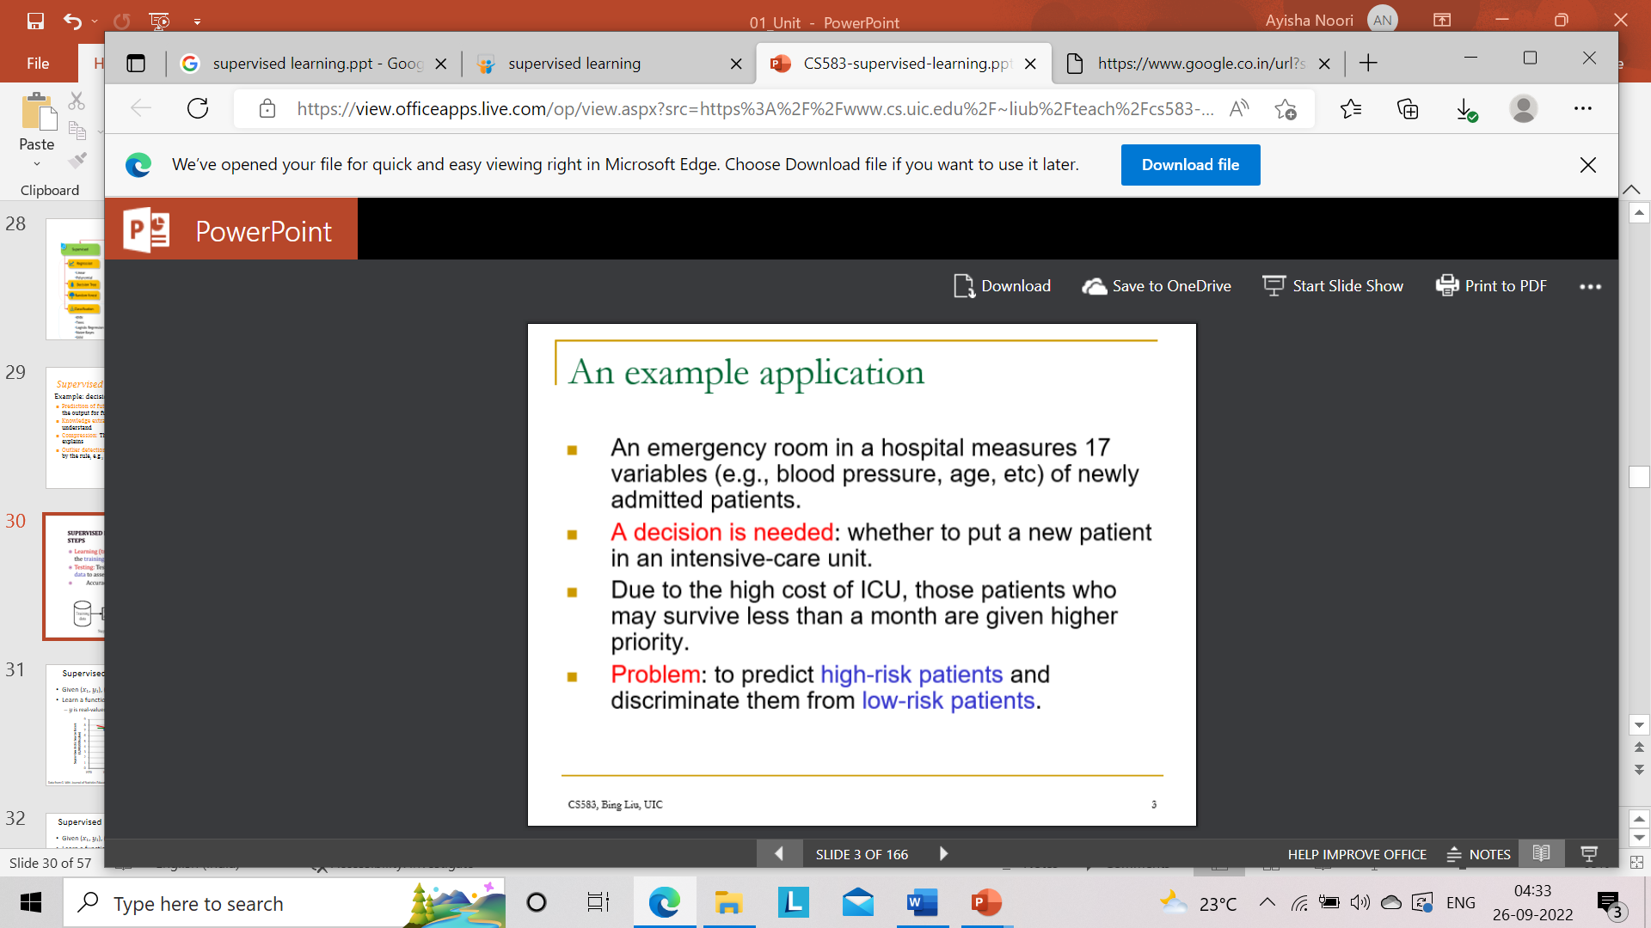

Slide 32
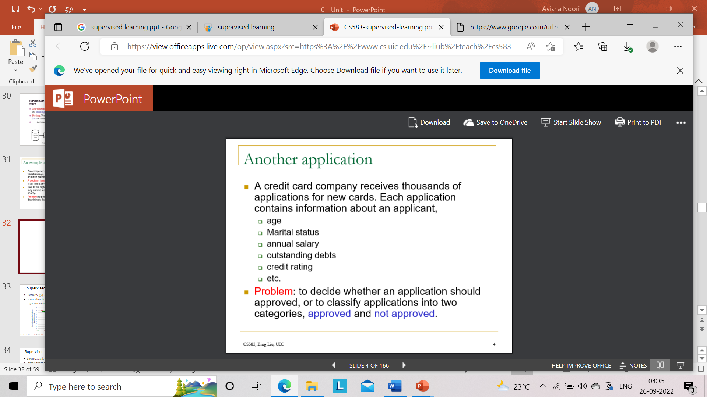

Slide 33










Supervised Learning: Classification
Given (x₁, y₁), (x₂, y₂), ..., (x_{n}, y_{n})
Learn a function f(x) to predict y given x
– y is categorical == classification
Breast Cancer (Malignant / Benign)
1(Malignant)
0(Benign)
Tumor Size
27
Based on example by Andrew Ng

Slide 34







Supervised Learning: Classification
Given (x₁, y₁), (x₂, y₂), ..., (x_{n}, y_{n})
Learn a function f(x) to predict y given x
– y is categorical == classification
Breast Cancer (Malignant / Benign)
1(Malignant)
0(Benign)
Tumor Size
Tumor Size
Based on example by Andrew Ng

Slide 35






Supervised Learning: Classification
Given (x₁, y₁), (x₂, y₂), ..., (x_{n}, y_{n})
Learn a function f(x) to predict y given x
– y is categorical == classification
Breast Cancer (Malignant / Benign)
1(Malignant)
0(Benign)
Tumor Size
Predict Benign Predict Malignant
Tumor Size
Based on example by Andrew Ng

Slide 36



Supervised Learning: Regression
Given (x₁, y₁), (x₂, y₂), ..., (x_{n}, y_{n})
Learn a function f(x) to predict y given x
– y is real-valued == regression
9
8
7
6
5
4
3
2
1
0
1970 1980
September Arctic Sea Ice Extent (1,000,000 sq km)
1990 2000
2010
2020
Year
Data from G. Witt. Journal of Statistics Education, Volume 21, Number 1 (2013)
26

Slide 37










Supervised Learning
x can be multi-dimensional
– Each dimension corresponds to an attribute
Clump Thickness
Uniformity of Cell Size
Uniformity of Cell Shape
…
Age
Tumor Size
30
Based on example by Andrew Ng

Slide 38
















Unsupervised Learning
Given x₁, x₂, ..., x_{n} (without labels)
Output hidden structure behind the x’s
– E.g., clustering
31

Slide 39
Unsupervised Learning
Unsupervised learning is a type of machine learning algorithm that brings order to the dataset and makes sense of data.
Unsupervised machine learning algorithms are used to group unstructured data according to its similarities and distinct patterns in the dataset.
The term “unsupervised” refers to the fact that the algorithm is not guided like a supervised learning algorithm.
The unsupervised machine learning algorithm is used to:
Explore the structure of the information and detect distinct patterns;
Extract valuable insights;
Implement this into its operation in order to increase the efficiency of the decision-making process
39

Slide 40
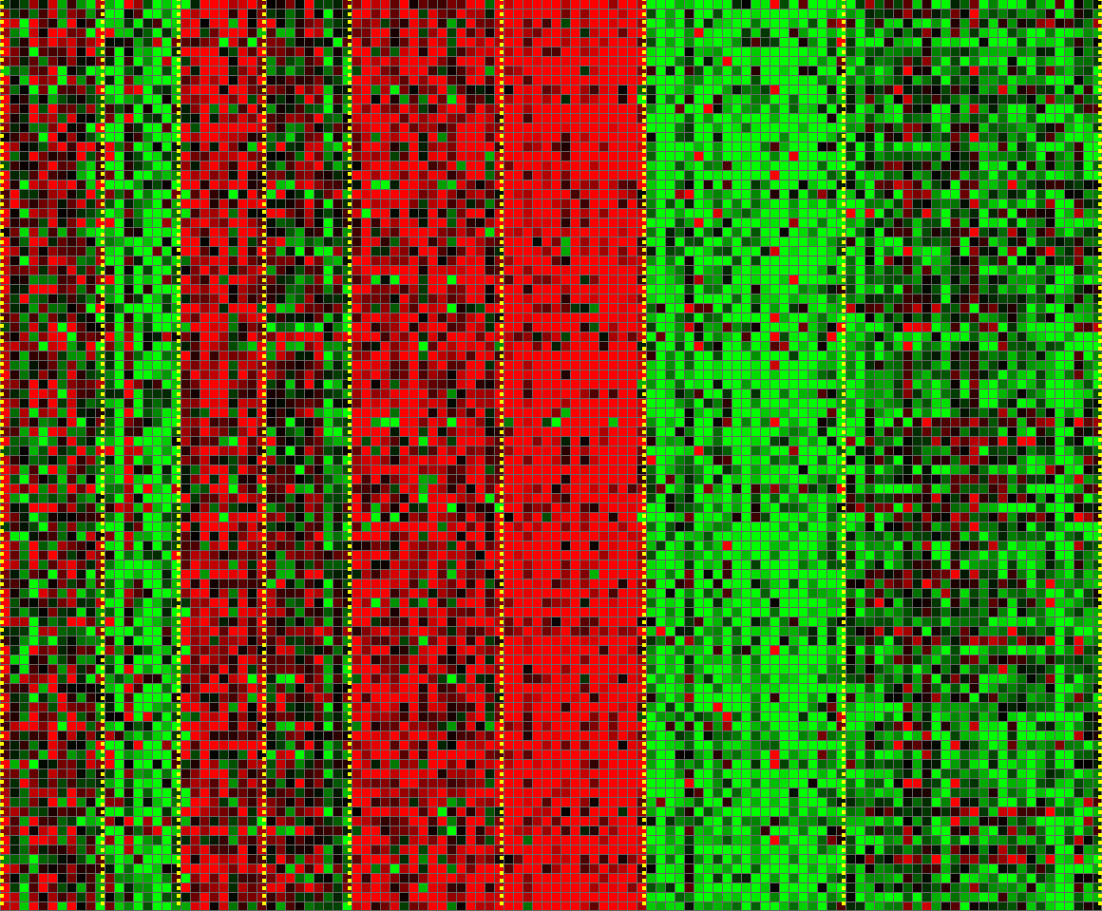
Unsupervised Learning
Genomics application: group individuals by genetic similarity
Genes
Individuals
32
[Source: Daphne Koller]

Slide 41

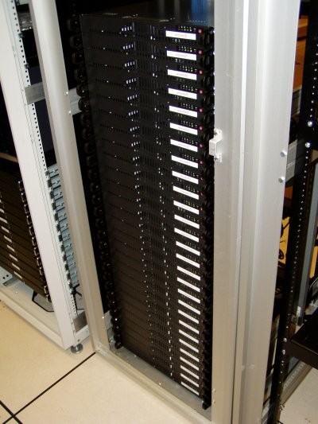
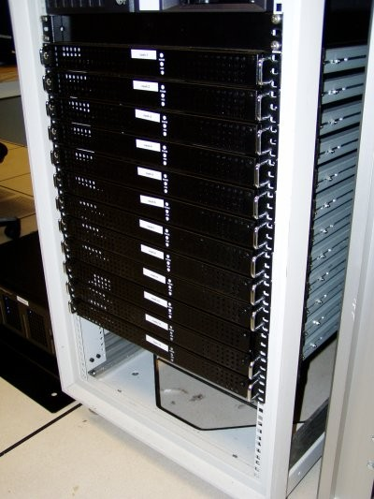




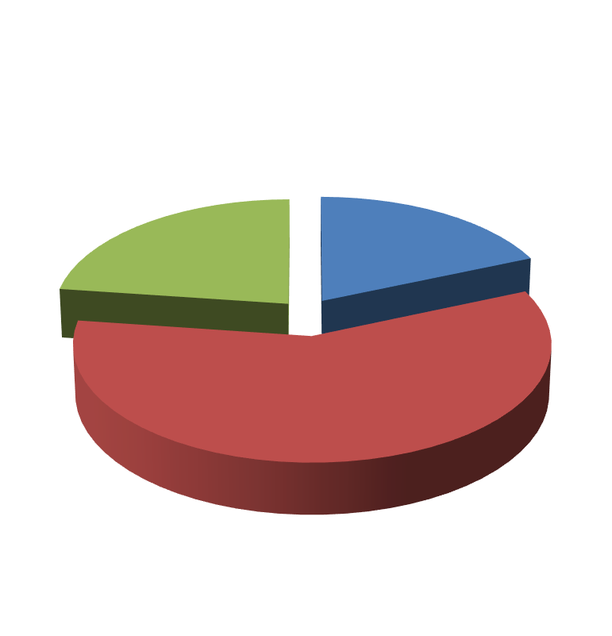

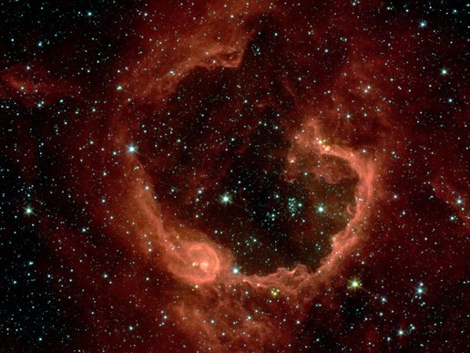


Unsupervised Learning
Organize computing clusters
Social network analysis
Market segmentation
Image credit: NASA/JPL-Caltech/E. Churchwell (Univ. of Wisconsin, Madison)
Astronomical data analysis
33

Slide 42
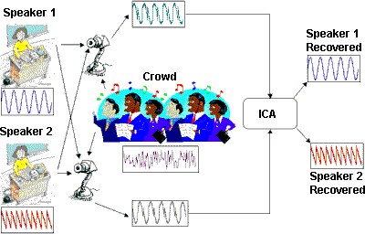


Unsupervised Learning
Independent component analysis – separate a combined signal into its original sources
Image credit: statsoft.com Audio from http://www.ism.ac.jp/~shiro/research/blindsep.html

Slide 43
Unsupervised Learning
Independent component analysis – separate a combined signal into its original sources
Image credit: statsoft.com Audio from http://www.ism.ac.jp/~shiro/research/blindsep.html

Slide 44
Reinforcement Learning
Learn how to behave successfully to achieve a goal while interacting with an external environment(Learn via Experience)
Given a sequence of states and actions with (delayed) rewards, output a policy
Policy is a mapping from states → actions that tells you what to do in a given state
Examples:
Credit assignment problem
Game playing
Robot in a maze
Balance a pole on your hand
36

Slide 45
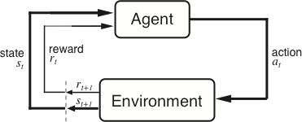
The Agent-Environment Interface
Agent and environment interact at discrete time steps Agent observes state at step t : s_{t} ∈S
: t = 0, 1, 2, K
produces action at step t : a_{t} ∈ A(s_{t} )
gets resulting reward : and resulting next state :
r_{t +1} ∈ℜ
^{s}t +1
. . .
^{r}t +1 _{st +1}
^{r}t +2 _{st +2}
^{r}t +3
. . .
s
t
a_{t}
^{s}t +3
ªt +1
ªt +2
ªt +3
37
Slide credit: Sutton & Barto

Slide 46
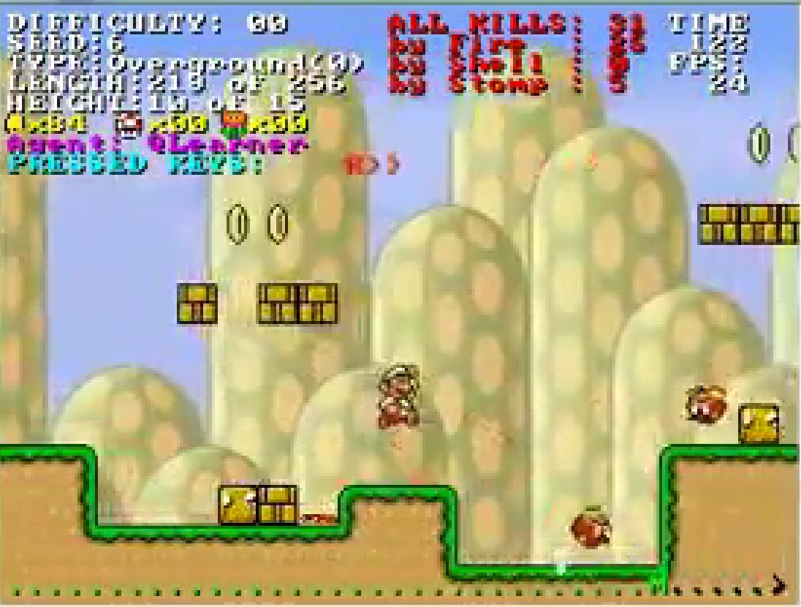
Reinforcement Learning
https://www.youtube.com/watch?v=4cgWya-wjgY

Slide 47

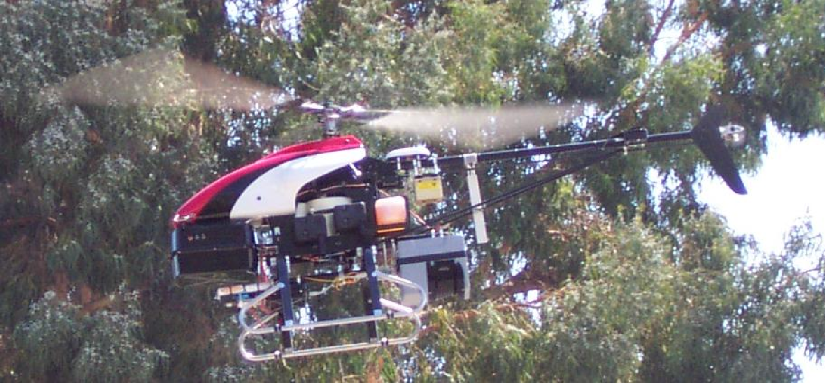
Inverse Reinforcement Learning
Learn policy from user demonstrations
Stanford Autonomous Helicopter http://heli.stanford.edu/ https://www.youtube.com/watch?v=VCdxqn0fcnE

Slide 48
Framing a Learning Problem

Slide 49






Designing a Learning System
Choose the training experience
Choose exactly what is to be learned
– i.e. the target function
Choose how to represent the target function
Choose a learning algorithm to infer the target function from the experience
Training data
Learner
Environment/ Experience
Knowledge
Testing data
Performance Element
41
Based on slide by Ray Mooney

Slide 50
Training vs. Test Distribution
We generally assume that the training and test examples are independently drawn from the same overall distribution of data
– We call this “i.i.d” which stands for “independent and identically distributed”
If examples are not independent, requires
collective classification
If test distribution is different, requires
transfer learning
42

Slide 51
ML in a Nutshell
Tens of thousands of machine learning algorithms
Hundreds new every year
Every ML algorithm has three components:
Representation
Optimization
Evaluation
43

Slide 52
Various Function Representations
Numerical functions
Linear regression
Neural networks
Support vector machines
Symbolic functions
Decision trees
Rules in propositional logic
Rules in first-order predicate logic
Instance-based functions
Nearest-neighbor
Case-based
Probabilistic Graphical Models
Naïve Bayes
Bayesian networks
Hidden-Markov Models (HMMs)
Probabilistic Context Free Grammars (PCFGs)
Markov networks

Slide 53
Various Search/Optimization Algorithms
Gradient descent
Perceptron
Backpropagation
Dynamic Programming
HMM Learning
PCFG Learning
Divide and Conquer
Decision tree induction
Rule learning
Evolutionary Computation
Genetic Algorithms (GAs)
Genetic Programming (GP)
Neuro-evolution
Slide credit: Ray Mooney

Slide 54


ML in Practice
Understand domain, prior knowledge, and goals
Data integration, selection, cleaning, pre-processing, etc.
Learn models
Interpret results
Consolidate and deploy discovered knowledge
Loop
48

Slide 55
Lessons Learned about Learning
Learning can be viewed as using direct or indirect experience to approximate a chosen target function.
Function approximation can be viewed as a search through a space of hypotheses (representations of functions) for one that best fits a set of training data.
Different learning methods assume different hypothesis spaces (representation languages) and/or employ different search techniques.
49

Slide 56
A Brief History of Machine Learning
50

Slide 57
History of Machine Learning
1950s
Samuel’s checker player
Selfridge’s Pandemonium
1960s:
Neural networks: Perceptron
Pattern recognition
Learning in the limit theory
Minsky and Papert prove limitations of Perceptron
1970s:
Symbolic concept induction
Winston’s arch learner
Expert systems and the knowledge acquisition bottleneck
Quinlan’s ID3
Michalski’s AQ and soybean diagnosis
Scientific discovery with BACON
Mathematical discovery with AM
Slide credit: Ray Mooney

Slide 58
History of Machine Learning (cont.)
1980s:
Advanced decision tree and rule learning
Explanation-based Learning (EBL)
Learning and planning and problem solving
Utility problem
Analogy
Cognitive architectures
Resurgence of neural networks (connectionism, backpropagation)
Valiant’s PAC Learning Theory
Focus on experimental methodology
1990s
Data mining
Adaptive software agents and web applications
Text learning
Reinforcement learning (RL)
Inductive Logic Programming (ILP)
Ensembles: Bagging, Boosting, and Stacking
Bayes Net learning
Slide credit: Ray Mooney

Slide 59
History of Machine Learning (cont.)
2000s
Support vector machines & kernel methods
Graphical models
Statistical relational learning
Transfer learning
Sequence labeling
Collective classification and structured outputs
Computer Systems Applications (Compilers, Debugging, Graphics, Security)
E-mail management
Personalized assistants that learn
Learning in robotics and vision
2010s
Deep learning systems
Learning for big data
Bayesian methods
Multi-task & lifelong learning
Applications to vision, speech, social networks, learning to read, etc.
– ???
Based on slide by Ray Mooney

